Slide 1

MGM college of engineering and technology
Title
Design and Development of Solar Energy System for Food Industry
GROUP MEMBERS UID NO:-
JOSHI VISHARAD BANDOPANT 419ME3072A
BUWA SURAJ NANDKISHORE 419ME3019A
DHAMANE RUTIK SHANTANU 419ME3027A
PATIL ROHIT VIJAY 419ME3188A

Slide 2
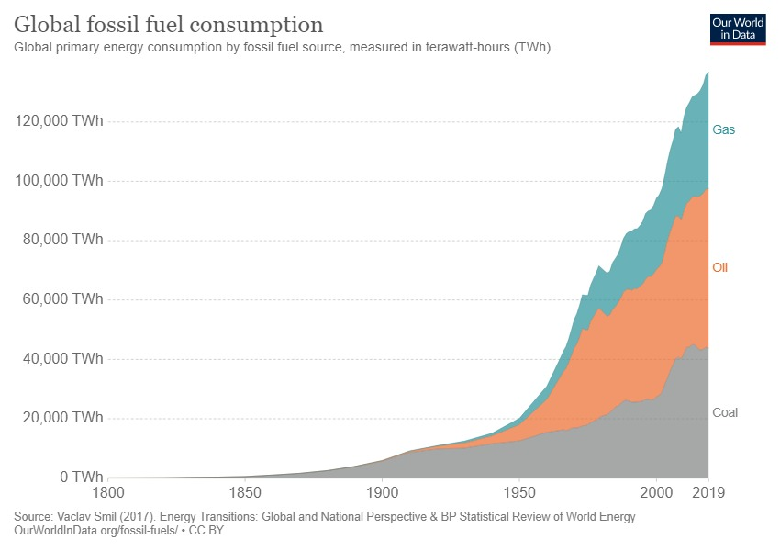
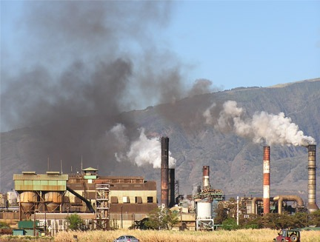
PROBLEM STATEMENT
Problem of existing system is less efficient in case of clean energy , due to which dependency on fossil fuel has increased over the decades
Consumption of Fossil Fuel:
Effect on consumption of Fossil Fuel :

Slide 3
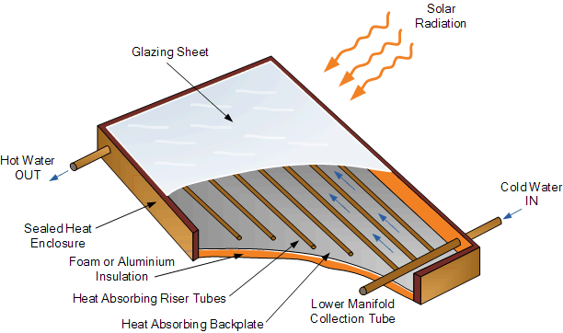
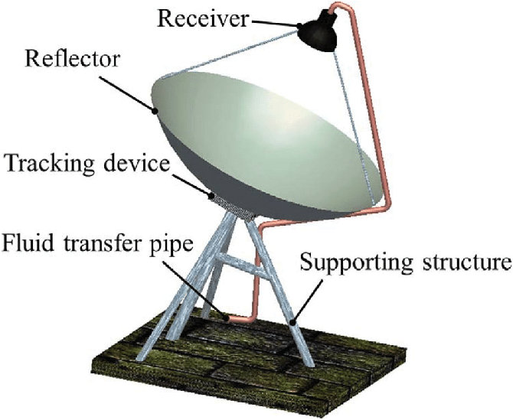
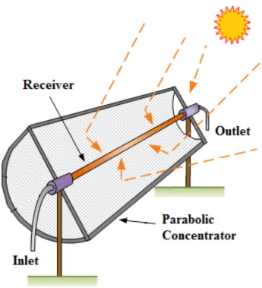
SOLUTION TO THE PROBLEM
TO BUILD THE EXCISTING SOLAR COLLETORS MORE EFFICIENT

Slide 4
METHOD ADOPTED FOR SOLUTION
TO USE CERTAIN GRADE AND MORE EFFICIENT MATERIAL LIKE
Reflector Material Selection
Material Properties | Silver | Aluminium | Copper | Stainless Steel
Reflectivity | 93-96% | 80-98% | 75% | 62-63%
Cost | Very High | Moderate | High | Low
 |  | Selected
The selection of the material to be used to reflect the incoming solar radiation. It affects heavily the amount of solar radiation transmitted to the receiver.

Slide 5
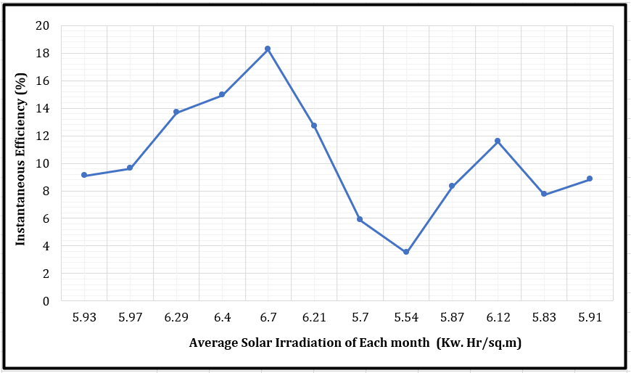
EXPECTED OUTCOME
INCREASE IN EFFICIENCY then existing system of about 2% to 3% with reduction in manufacturing cost
Avg. thermal efficiency of current system is about 17%

